Slide 1





Car Damage Assessment Using Machine Learning

Slide 2
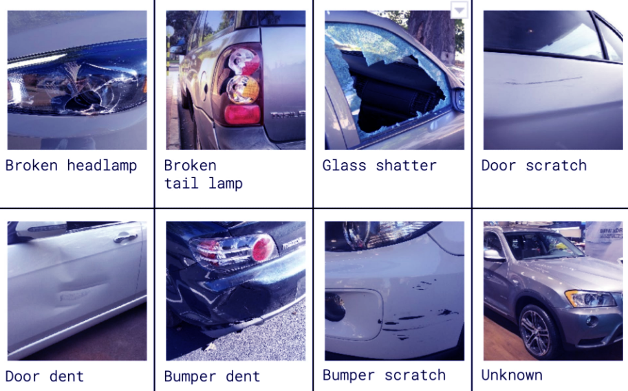
The essence of the database:
The illustration show sample images from the various classes in the dataset.
Note that the unknown class contains images of cars that are in either pristine or wrecked condition.
Door dent: 13% | Unknown: 28% | Head Lamp: 9% | Tail Lamp: 9% | Glass Shatter: 12% | Bumper Dent: 8% | Door Scratch: 13% | Bumper Scratch: 8%

Slide 3

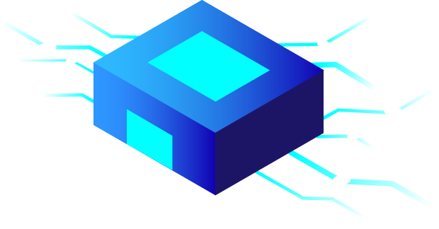

Questions about the database:
What are the success rates in image classification?
Is machine learning effective in classifying a large number of classes?
How much does modeling the image into a vector affect learning? (Flatten VS VGG)
How much do image features affect learning?

Slide 4
Algorithms
CNN
A concept of a neural network, Its main attributes may be that it consists of convolution layers, pooling layers , activation layers etc.
SVM
Works by mapping data to a high-dimensional feature space so that data points can be categorized, even when the data are not otherwise linearly separable. A separator between the categories is found, then the data are transformed in such a way that the separator could be drawn as a hyperplane. Following this, characteristics of new data can be used to predict the group to which a new record should belong
CNN
SVM
works by finding the distances between a query and all the examples in the data, selecting the specified number examples (K) closest to the query, then votes for the most frequent label (in the case of classification) or averages the labels (in the case of regression)
KNN
DT use multiple algorithms to decide to split a node into two or more sub-nodes. The creation of sub-nodes increases the homogeneity of resultant sub-nodes. In other words, we can say that the purity of the node increases with respect to the target variable. The decision tree splits the nodes on all available variables and then selects the split which results in most homogeneous sub-nodes
DT
KNN
DT

Slide 5
Results
75
50
25
0
CNN
SVM
KNN
DT
Using VGG
Using Flatten

Slide 6
Main Challenges
Loss of information obtained from the image columns as a result of performing Flatten (converting the image to vector) Overcoming: By using VGG
Classification into a larger number of classes Overcoming: By using larger images that provide more information (224X224)

Slide 7
Techniques
Bilateral filter
Noise removal while maintaining edges
Gaussian Filter Bilateral Filter

Slide 8
Techniques
Sharp Via Laplacian Of Gaussian
Sharpening edges by subtracting the second derivative of the
image from the original image
Original Sharpen

Slide 9
Techniques
Canny
Finding the edges by the first derivative of the image and filtering
the results with the assumption that the edges are long and
connected together (using angles)
Original Edges

Slide 10
Techniques
Histogram Equalization
Increasing image contrast (larger changes between pixels)
Before After

Slide 11
Techniques
White Balance
Corrects the color appearance of the image
based on the white color

Slide 12
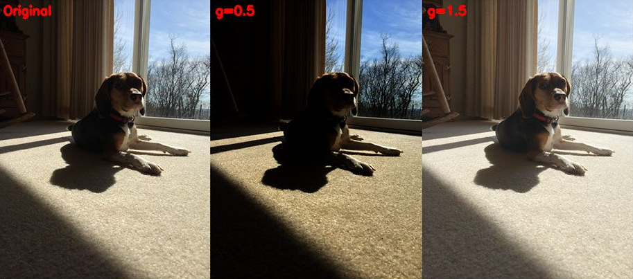
Techniques
Gamma Correction
Change the brightness of the image

Slide 13
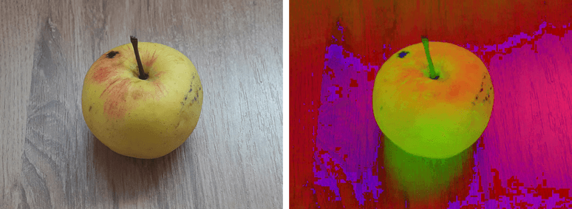
Techniques
HSV
Color space that defined by hue (color range),
saturation (darkness range), value (brightness range)
RGB HSV

Slide 14
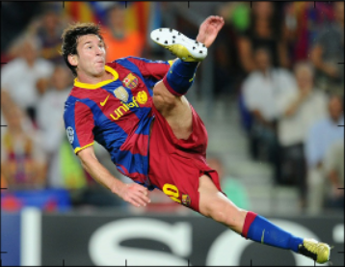
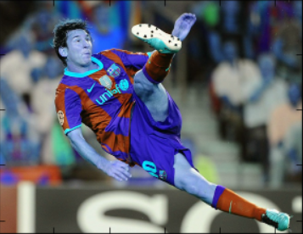
Techniques
BGR
Color space similar to RGB color space but in reverse layout
RGB BGR

Slide 15
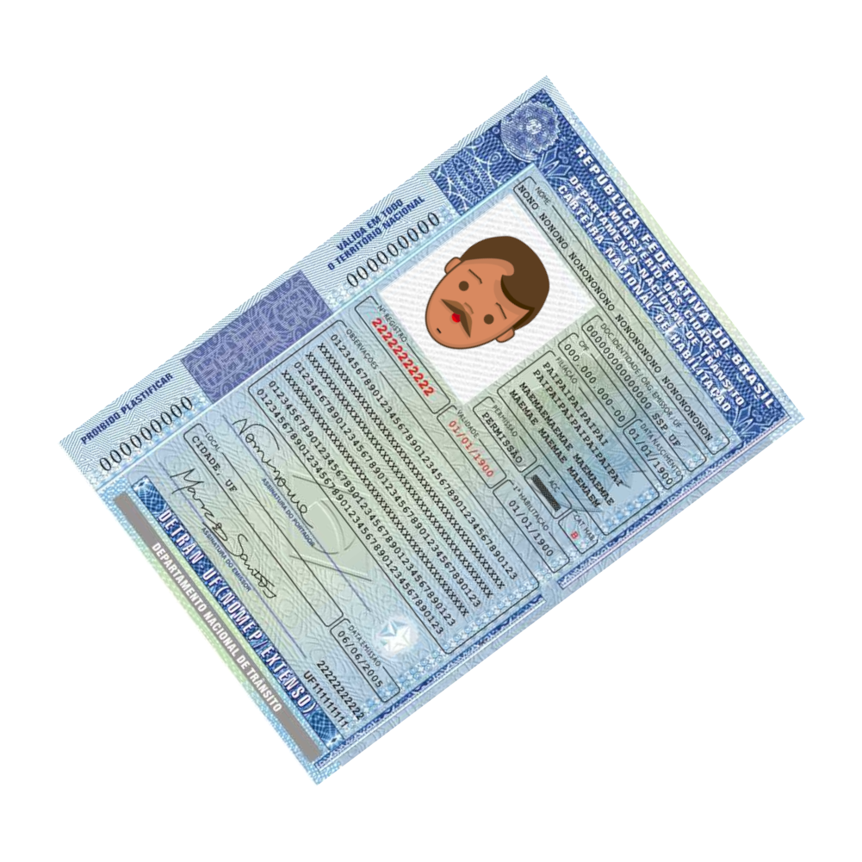
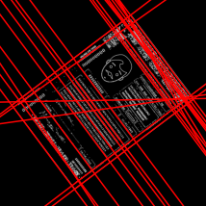
Techniques
Hough Line Transform
Finding a parametric shape (characterized by parameters like line) by mapping
each edge pixel to a new space whose dimensions represent the shape parameters

Slide 16
Techniques
… And more tweaks like:
Mean reduction
Resized Images (112X112)

Slide 17
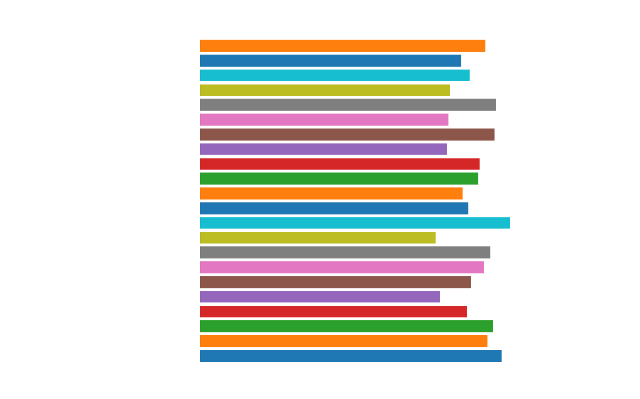
Techniques Results

Slide 18
Analysis Of The Techniques
Hough Line Transform - Loss of information of the image corners as a result of rotation
Using Canny – Over-adjustment to a specific image as a result of highlighting the objects
HSV - Loss of color distribution (to a smaller number)
Histogram Equalization - Loss of color matching between images due to minimum and maximum value
Black & White - Loss of information due to image colors
Image Reduction - information loss / aliasing

Slide 19
Analysis Of The Algorithms
Rising trend in success rates
How each algorithm behaved?
Compare the different algorithms

Slide 20
Rising Trend In Success Rates
By simply randomly guessing, you should be able to reach ~ 12.5% accuracy (since there are eight class labels).
After running the algorithms (SVM, DT, KNN) with Flatten we get ~ 35% accuracy (+22.5%)
After running CNN algorithm with Flatten we get ~ 55% accuracy (+42.5%)
After running the algorithms (DT, KNN) with VGG we get ~ 65% accuracy (+52.5%)
After running CNN & SVM algorithms with VGG we get ~ 75% accuracy (+62.5%)!!

Slide 21
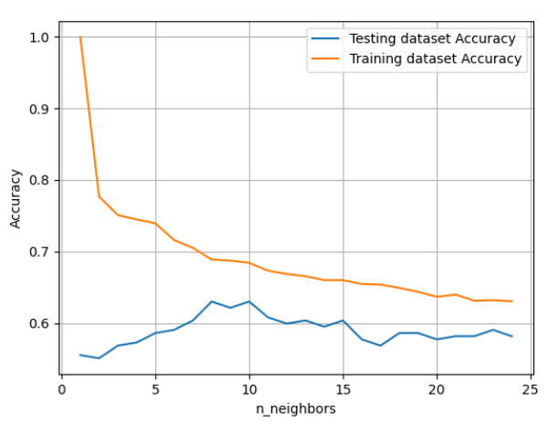
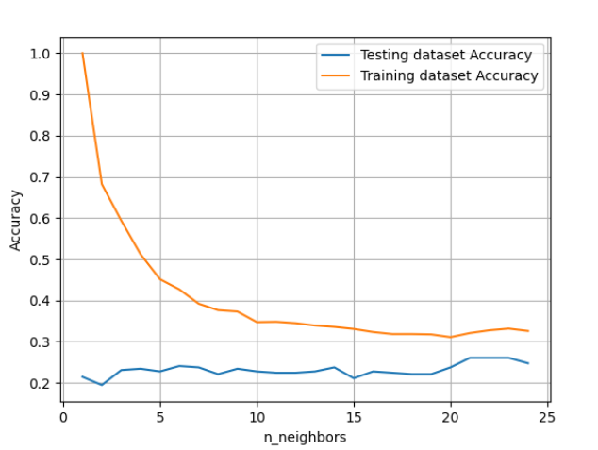
K-Nearest Neighbors Algorithm
k should be wisely selected. (k~8-10 is the best result with VGG)
Success rates are very low with Flatten because we're losing information from the image columns.
VGG
Flatten

Slide 22
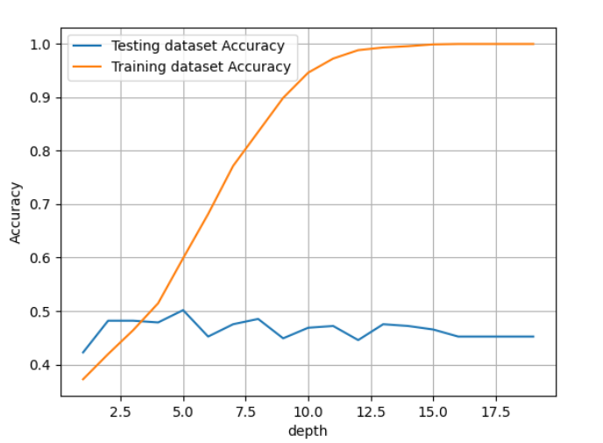
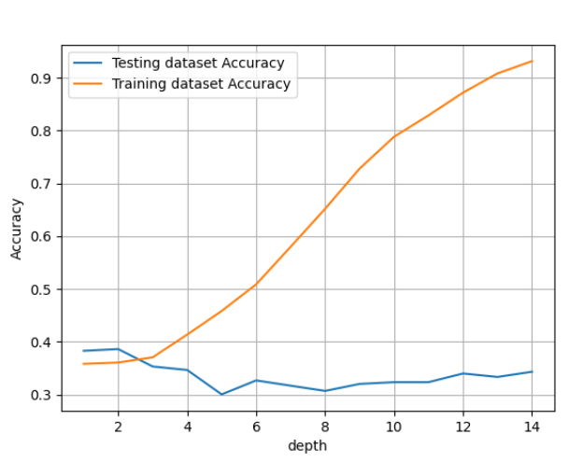
Decision Tree Algorithm
Tree may grow to be very complex while training complicated datasets.
VGG reaches high percentages in larger trees compared to Flatten
VGG
Flatten

Slide 23
k-NN vs DT
In both with Flatten we can demonstrate there is an underlying pattern to the images for both raw pixel intensities.
Decision tree is faster due to KNN’s expensive real time execution.
KNN gives better results than DT after VGG because processing is done for numerical data

Slide 24
SVM vs DT & k-NN
SVM gives better results than DT & KNN after VGG
Decision trees are better for categorical data and it deals collinearity better than SVM.
SVM take cares of outliers better than KNN.
SVM outperforms KNN when there are large features and lesser training data.

Slide 25
SVM vs CNN
SVM can perform better than NN when there are limited training data and many features. NN needs large training data for sufficient accuracy.
Multi class classification requires multiple models for SVM, whereas NN can do it with a single model.

Slide 26
Credits
Authors:
Almog Jakov
Itay Rafee
Visit Us:
https://github.com/AlmogJakov
https://github.com/itay-rafee
Made Using PowerPoint®

Slide 27
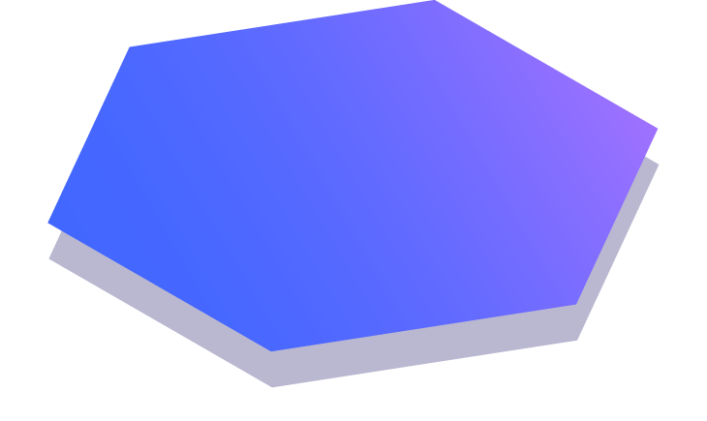
Thanks!

